Slide 1
Polymers
Molecules for living

Slide 2
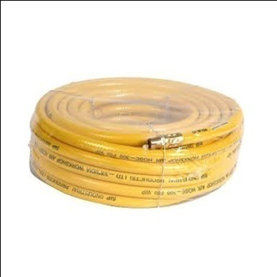
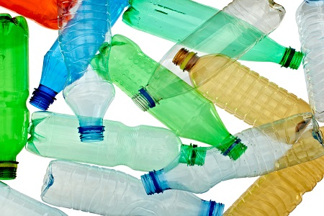
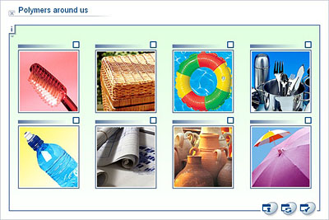
Macromolecules
A giant or a large molecule, made up of many many atoms and had a large molecular mass.
They are also called Polymers, are large molecules consisting of a large number of smaller molecules (monomers) bonded together.
Monomer- A relatively small molecule that can form covalent bonds with other molecules of this type to form a polymer.

Slide 3
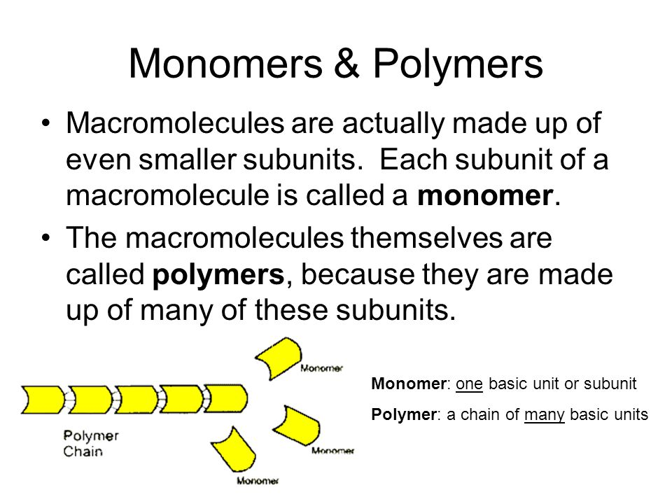
onomer

Slide 4
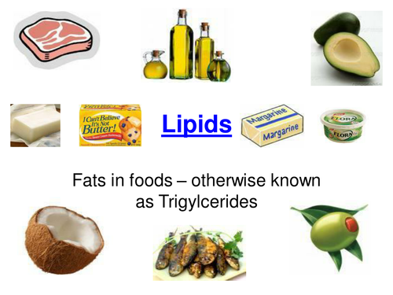
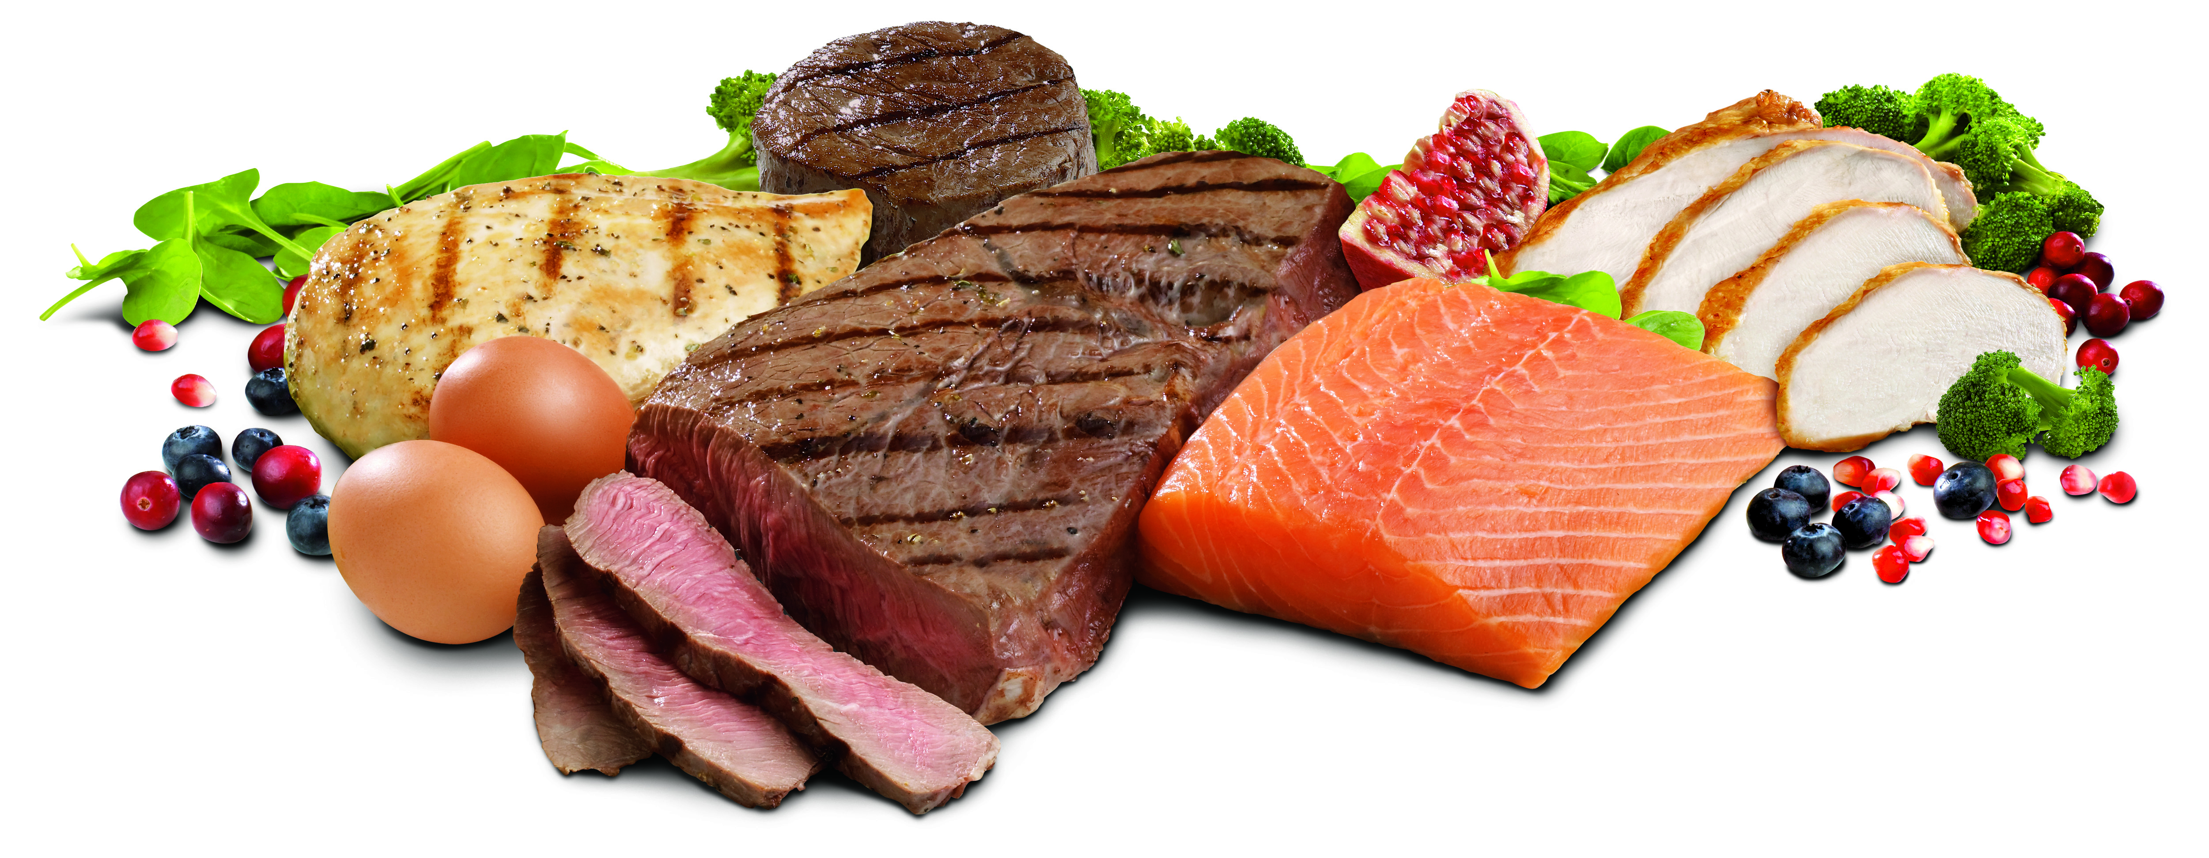
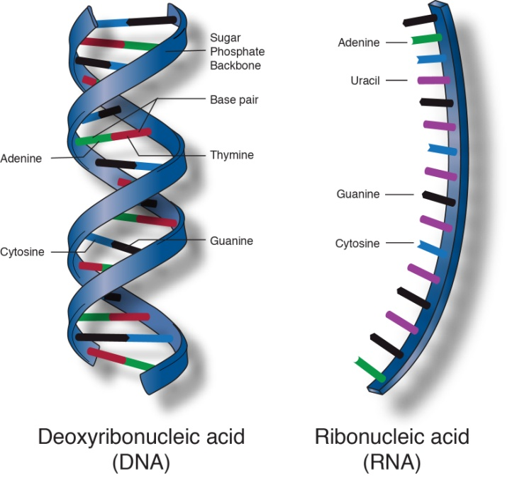
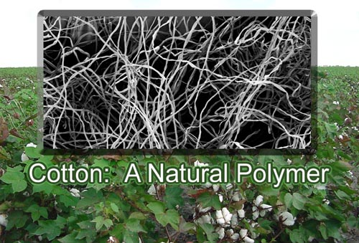
Biological macromolecules are important cellular components and perform a wide array of functions necessary for the survival and growth of living organisms. The four major classes of biological macromolecules are carbohydrates, lipids, proteins, and nucleic acids.

Slide 5
Synthetic Polymers
Synthetic polymers are man-made and are either:
Thermoplastic – soften on heating, easy to recycle, used in plastic bags, soft drink bottles and garden hoses.
Thermosetting – do not change shape when heated so are not recyclable. Are stronger than thermoplastic. Used in insulating foam, surfaces and electrical insulation.

Slide 6
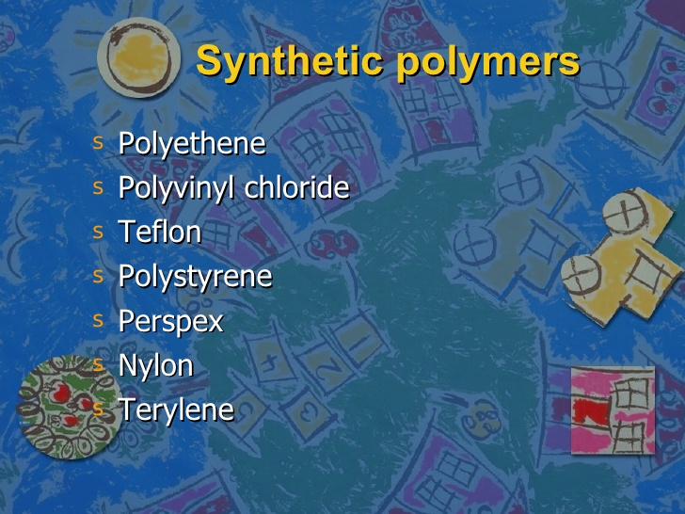

Slide 7
Polymerization reactions
Any chemical process in which relatively small molecules, called monomers, combine to produce a very large chainlike or network molecule, called a polymer.
Two main types of polymerization reactions.
Addition Polymerization reaction
Condensation Polymerization reaction.

Slide 8
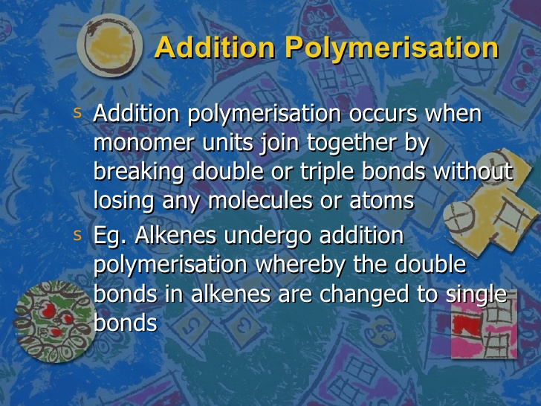
Addition polymerization

Slide 9
The addition process
When a monomer contains a double bond, such as ethene, it can join to other monomers to create a long carbon chain without any loss of atoms.
This is an addition reaction and the polymer formed is called an addition polymer.
The properties of the final polymer depend on the structure of the monomer, including any side chains and its carbon chain length.

Slide 10
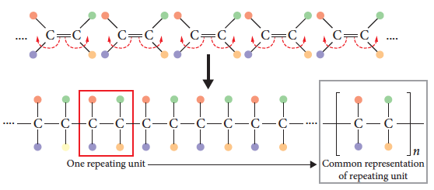
The addition process
A polymer consists of a number of monomers that can range from 100 to more than 100 000 units.

Slide 11
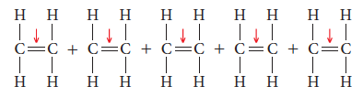
Ethene polymers – polyethylene
Ethene (or ethylene) molecules join to form a long chain polymer called polyethene. The preferred name for this polymer is polyethylene.
A catalyst is added to the ethene monomers causing the carbon–carbon double bond to break.

Slide 12
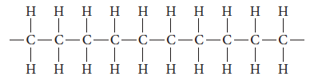
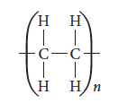
Ethene polymers – polyethylene
As each monomer now has free electrons, carbon–carbon bonds form between monomers, creating a long chain polymer.
A shorthand way of representing polyethylene is:
(n = number monomer units)

Slide 13
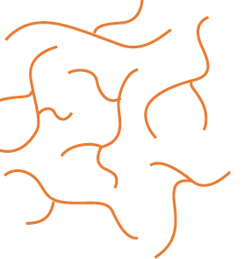
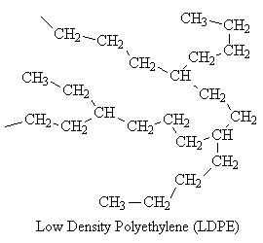
Ethene polymers – LDPE- Low Density PolyEthylene
Produced using high temperature 300º C and pressure 1000-3000 atm and an initiator to start the reaction.
A branched structure or side chains forms that does not allow for close packing due to the branches. This is Low Density PolyEthylene (LDPE).
This is a flexible polymer with a
low melting point and low density.

Slide 14
LDPE
The side branches stop the polymer molecules from lining up regularly. Its structure is not crystalline, its amorphous.
This means that:
the material has a lower density than HDPE
the inter molecular dispersion forces of attraction between polymer molecules are weakened.
the material is less strong, and has a lower melting point, than HDPE

Slide 15
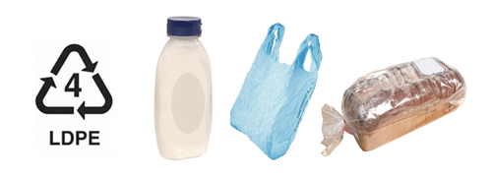
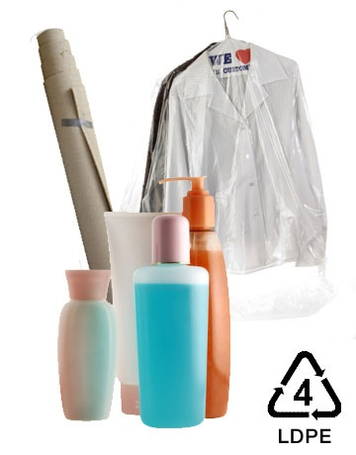
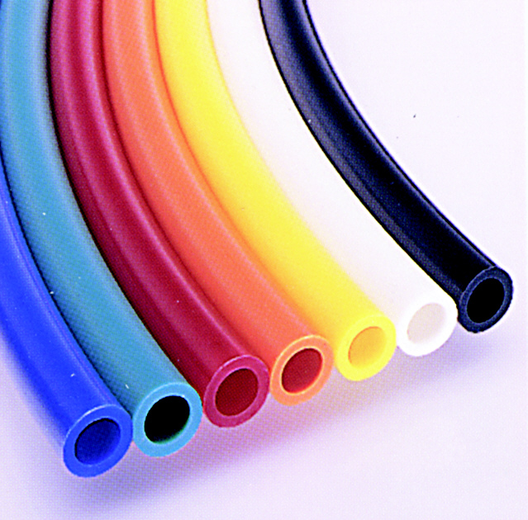
Uses of LDPE
Food wrap films
Garbage bags
Squeeze bottles
Flexible toys
Flexible utensils
Hose pipe
Electrical wires.

Slide 16
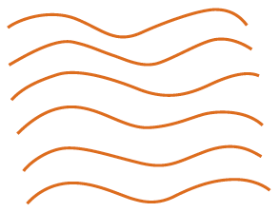
Ethene polymers - HDPE
High Density PolyEthylene (HDPE) is produced using the Ziegler–Natta process. This requires lower pressures 1-4 times lower and temperatures 60⁰C and a catalyst.
An unbranched polymer forms that is higher density with a higher melting point. It is also less flexible.
Notes:
Experiment 7.1 – Investigating crystalline and amorphous packing of polymer chains.

Slide 17
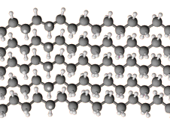
HDPE
The polymer molecules line up regularly to give a crystalline structure.
This means that:
the material has a higher density than LDPE
the dispersion forces between polymer molecules are strong.
the material is stronger, and has a higher melting point, than LDPE

Slide 18
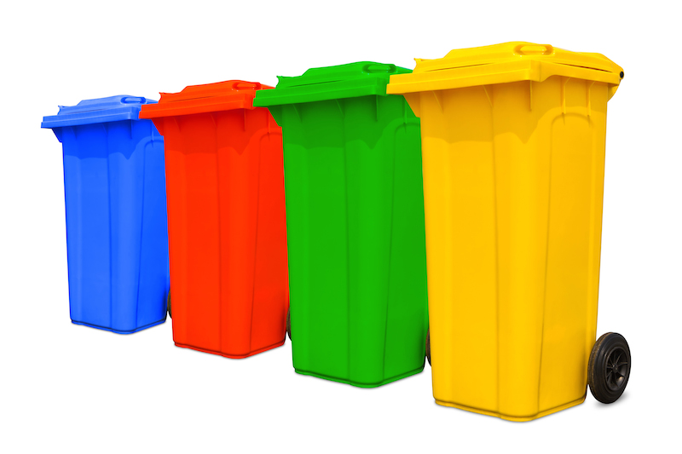
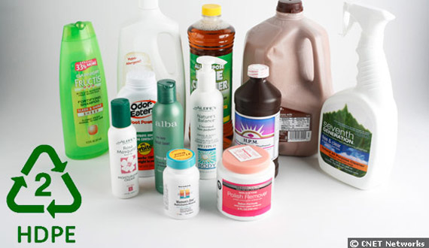
Uses of HDPE
Food containers,
Fuel tanks
Picnic wares
Household and kitchen ware
Pipes
Carry bags

Slide 19
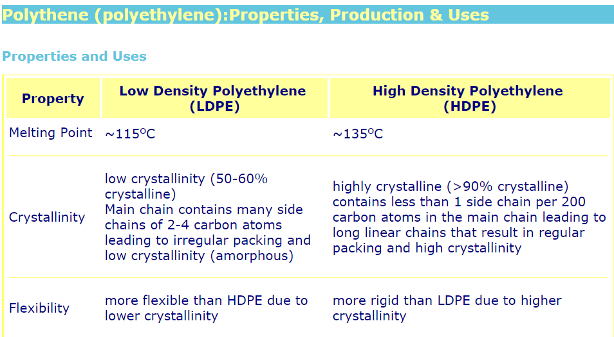

Slide 20
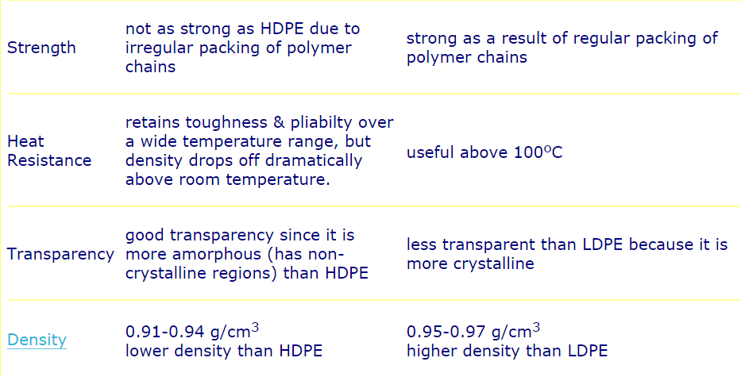

Slide 21
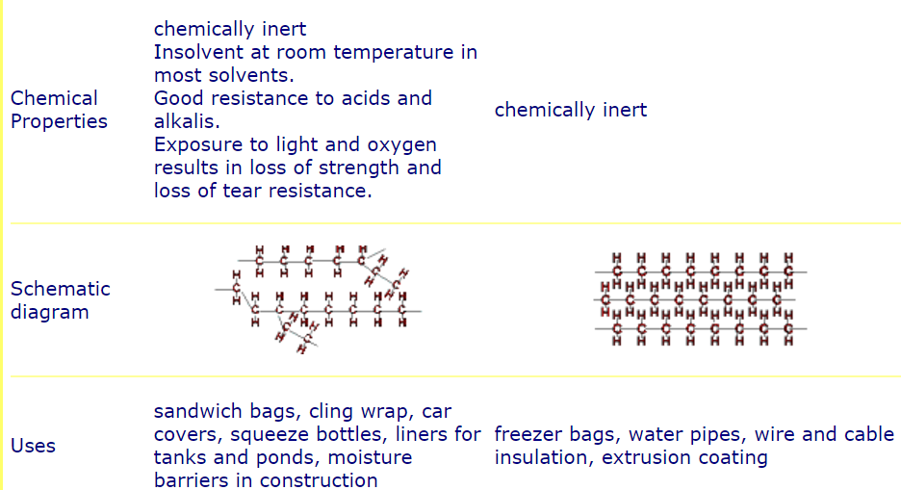

Slide 22
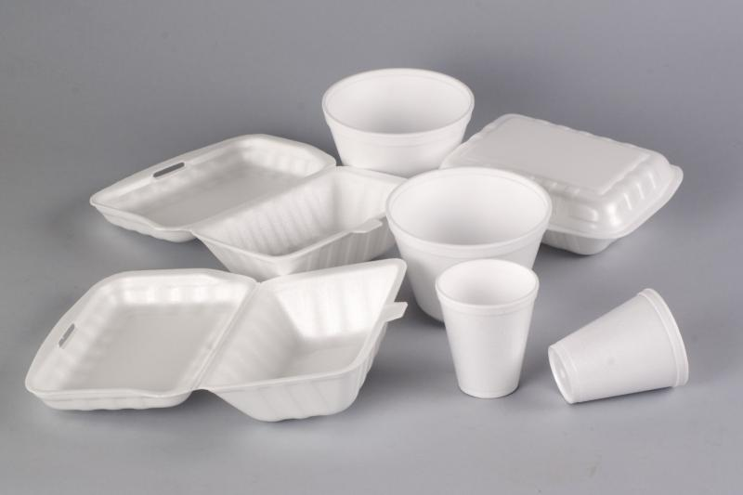
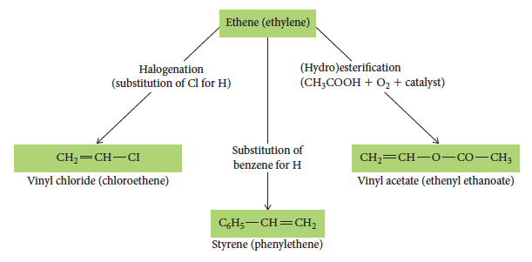
Other polymers
Ethene can also be used to create other monomers that form polymers, such as polystyrene and PVC.

Slide 23
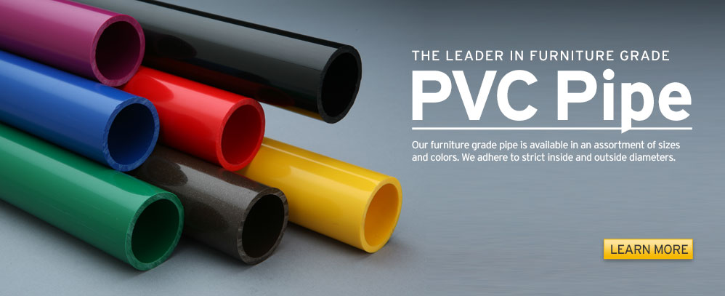
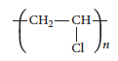
PVC
PVC or polyvinylchloride is made from the vinyl chloride monomer:
The polymer produced is amorphous (does not pack well) due to the chlorine atoms off the main chain.
PVC is a hard, non-flexible polymer used for pipes. To make it more flexible, a plasticiser is added that pushes the chains apart and reduces bonding between chains.
Notes:
Alternately the textbook has similar information on Polystyrene and Polypropylene
Table C7.2 provides comparison information on a range of addition polymers.

Slide 24
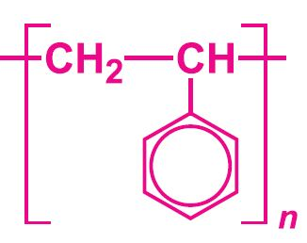
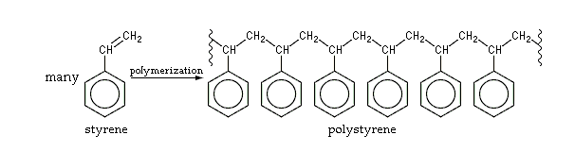
Polystyrene
Phenyl rings oriented randomly along the chain. It is amorphous due to large size of the side group as they prevent polymer chains to pack closely. The benzene ring also restrict the ability of the chain to flop around so it is hard and brittle. There are no polar bonds only weak dispersion forces are presents.

Slide 25
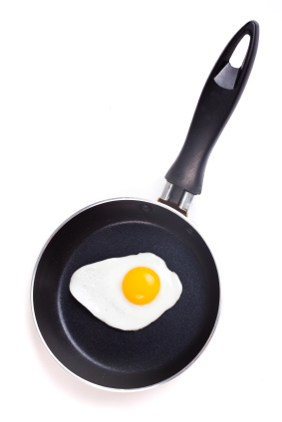
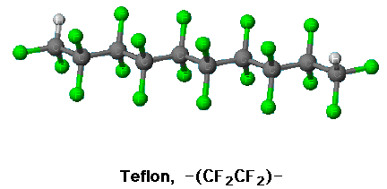
Teflon- poytetrafluoroethene
Refer to table 2 pg 148 –Essential chemistry unit 3&4 book.

Slide 26
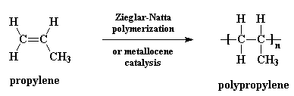
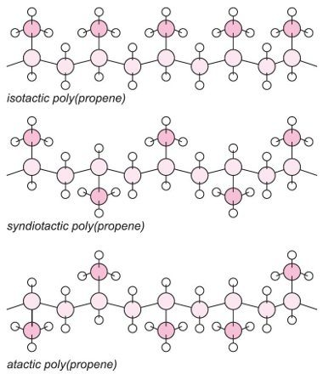
Polypropylene (PP)
There are variations of the structure of the polymer depending on the orientation of the alkyl group.
Isotactic- closely packed chains, large dispersion forces so hard and strong
Syndotactic-fairly closely packed, average dispersion forces, hence hard but softer than isotactic
Atactic- chains are not closely packed, weak dispersion forces, softer and low melting point.

Slide 27
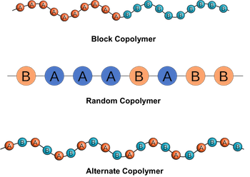
Copolymers
If more than one type of monomer is used in the addition process, the properties of the final polymer can be controlled/designed.
A copolymer has a polymer structure formed from more than one type of monomer.
The copolymer formed has properties different from that of the polymer composed of only one of the constituent monomers.
->Eg Synthetic rubber polymer of styrene and butadiene

Slide 28
Properties of Polymers
Polymers can be synthesised or chosen to have particular properties.
Structural features such as level of branching, the amount and type of cross links and the presence of particular side groups can influence properties including melting point and flexibility.
Common structural feature are:
crystallinity
Branching
Chain length
Side groups
Cross linking
Stability and bioderability

Slide 29
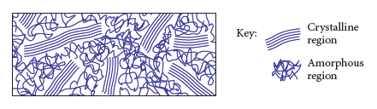
Crystallinity
As polymer chains form, they can wrap around each other causing areas of order (crystalline region) and disorder (amorphous region).

Slide 30
Crystallinity
Highly crystalline polymers pack more closely than amorphous polymers, so have a higher density.
Their intermolecular bonding is stronger than amorphous polymers, so they have higher melting points and are stronger and more rigid.
Crystalline polymers are also more opaque and the close packing does not allow entry of air, water or chemicals, so they are more resistant to chemicals.

Slide 31
Branching
Highly branched chains cannot pack as closely as unbranched polymers.
Unbranched polymers are denser (more closely packed), more crystalline, less transparent and less flexible.
To make a branched polymer with alternate properties requires extreme reaction conditions in order to break carbon–carbon bonds.

Slide 32
Chain length
Chain length affects the production of the polymer. In the production process, chains of different lengths are produced.
Long chain polymers have more intermolecular forces between chains so have higher melting points and are harder substances.

Slide 33
Side groups
The side groups that are attached to the main chain can change properties of the polymer.
A larger side group can change the flexibility of the polymer, making it more rigid.
Replacing atoms, for example replacing a hydrogen with a chlorine, stiffens the polymer.

Slide 34
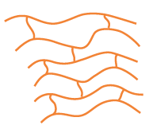
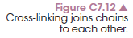
Cross-linking
Cross-linking involves joining linear polymer chains through ionic or covalent bonds between the chains.
These are strong bonds and increase the hardness and rigidity of the polymer.
Eg- Natural Rubber heated with Sulfur, polymer is harder and more elastic
Notes:
Experiment 7.2 – Making a cross-linked polymer – making a polymer from borax and PVA glue.

Slide 35
Stability/biodegradability
The bonds between most atoms in a polymer are covalent, so are quite difficult to break.
This means they are not biodegradable because they do not break down easily over time.
To increase biodegradability, copolymers are created with natural monomers, such as glucose, that break down in nature, so the polymer will break down when thrown out.
Notes:
Investigation 7.1 – Identifying platsics by their density.

Slide 36
Condensation polymers https://www.youtube.com/watch?v=-d14DmSBuAQ https://www.youtube.com/watch?v=rHxxLYzJ8Sw

Slide 37
What is a condensation polymer?
A condensation polymer forms through a condensation reaction between a carboxylic acid and either an alcohol or an amine.
This forms either an ester or amide group that becomes part of the main polymer chain.
The monomers must therefore have these functional groups.

Slide 38
Polyesters – preparation
A polyester forms when a monomer with a hydroxyl group reacts with a monomer with a carboxylic acid group.
A molecule of water is eliminated for every bond that forms between monomers.
Many ester links form within the chain, hence a polyester.

Slide 39
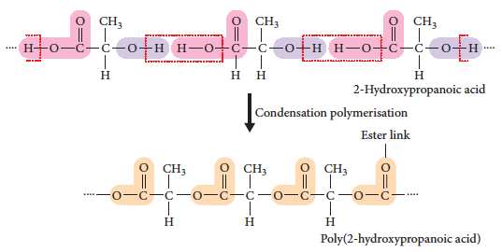
Polyesters – preparation

Slide 40
Single and double monomers
When preparing a polyester the monomers can have various configurations.
Option 1: a single monomer is used – it has a hydroxyl group at one end and a carboxylic acid at the other end.
Option 2: two different monomers are used – one is a diol (two hydroxyl groups, one at each end) and the other is a dicarboxylic acid.

Slide 41
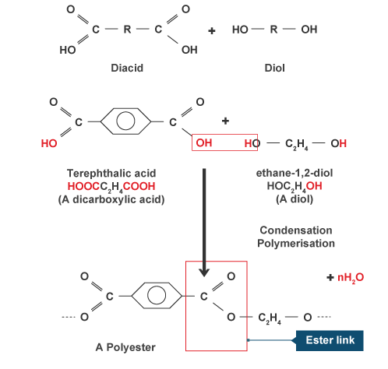
Polyester Synthesis

Slide 42
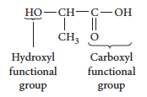
PLA – a single monomer example
PLA or polylactic acid is prepared using a single monomer.
It has one of each of the required functional groups in the same monomer. The monomers line up so the hydroxyl group is next to the acid group and a reaction can occur.

Slide 43
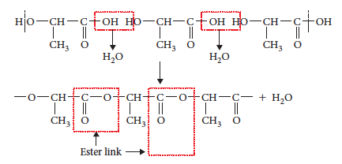
PLA – a single monomer example

Slide 44
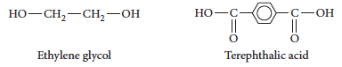
PET – double monomer example
PET, or polyethylene terephthalate, is used in clothing, bottles and a wide range of plastics.
Two monomers are used to make PET, one a diol (ethylene glycol), the other a dicarboxylic acid (terephthalic acid).

Slide 45
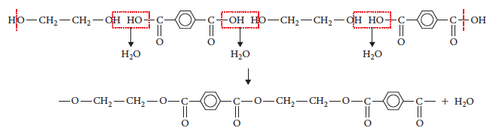
PET – double monomer example

Slide 46
Polyamides – preparation
Reaction between a monomer with an amine group and a monomer with a carboxylic acid group forms a condensation polymer called a polyamide.
Again, a single monomer with both functional groups can be used. Alternatively, two monomers, one diamine and one dicarboxylic acid can be used.

Slide 47
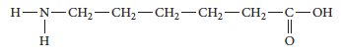
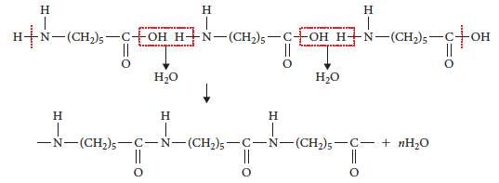
Polyamide – single monomer – nylon-6
Use of a single monomer:

Slide 48
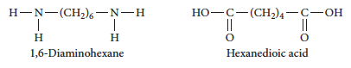
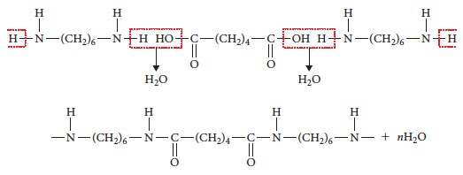
Polyamide – double monomer – nylon-6-6

Slide 49
Chapter 7: Molecules for living
Carbohydrates

Slide 50
What is a carbohydrate?
Carbohydrates include simple sugars, such as glucose and sucrose, and natural polymers, such as cellulose or starch.
The properties of carbohydrates depend on their structure.
Glucose, sucrose, cellulose and starch all contain glucose molecules, but the different arrangement gives very different properties.

Slide 51

Structure
All carbohydrates contain carbon, hydrogen and oxygen. The carbon atoms are arranged in a ring structure, usually containing 4 to 6 carbons.
The carbons are bonded to OH groups and H atoms. Larger molecules contain multiple rings bonded together.

Slide 52


Monosaccharides
Monosaccharides have a single ring structure and commonly have the formula C₆H₁₂O₆.
They include glucose, fructose and galactose.

Slide 53
Monosaccharides
The positioning of the OH groups differentiates the two structures.
On the carbon on the left side, the OH group is below the carbon for glucose, but above the carbon for galactose.
This gives them different properties.

Slide 54

Monosaccharides
Glucose has two isomers, called α-glucose and β-glucose (alpha and beta glucose) that vary in the placement of the OH group on the C₁ carbon.

Slide 55

Disaccharides
Joining two monosaccharide ring structures forms a disaccharide, a double ring structure, joined by a glycosidic link: –C–O–C–.
This is a condensation reaction as a molecule of water is eliminated during the reaction.
Formation of sucrose from two glucose molecules:

Slide 56

Disaccharides
As monosaccharides, especially glucose, can have isomers and placings of the OH groups, the joining of these structures is more complex.
Notes:
Experiment 7.3 – Analysing sugar in soft drinks.

Slide 57
Disaccharides
When two glucose molecules join, maltose forms. When a glucose and galactose molecule join, lactose is formed.
The different disaccharides have different properties, depending on how the monosaccharides join together.
For example, sucrose and fructose are sweet, while maltose and galactose are not.
Notes:
Experiment 7.3 – Analysing sugar in soft drinks.

Slide 58

Naming Polymers

Slide 59


Slide 60


Slide 61


Slide 62




Slide 63



Naming Nylon

